Slide 1
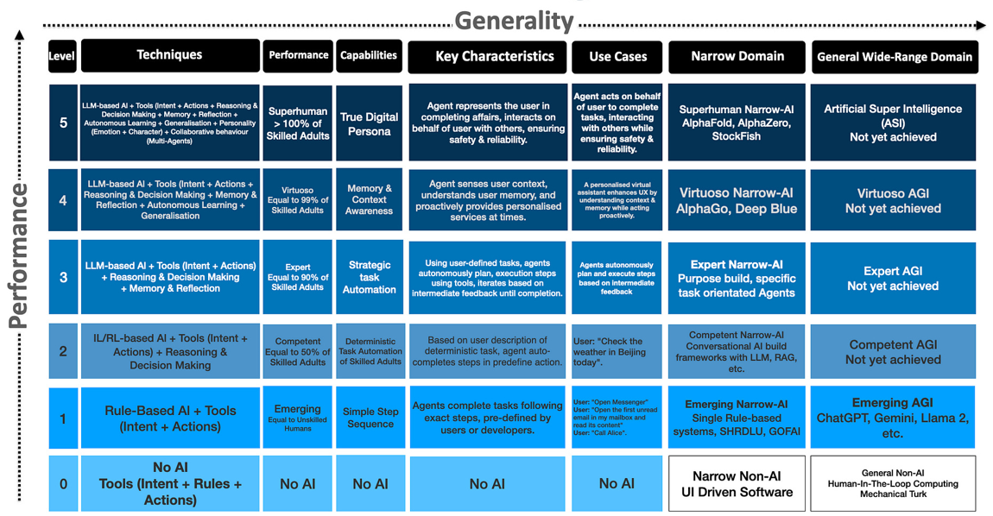
5 Levels of AI Agents
𝗔𝘂𝘁𝗼𝗻𝗼𝗺𝗼𝘂𝘀 𝗔𝗜 𝗔𝗴𝗲𝗻𝘁𝘀 are AI systems capable of performing a series of complex tasks independently to achieve a goal
Source: https://arxiv.org/pdf/2405.06643
Cobus Greyling

Slide 2
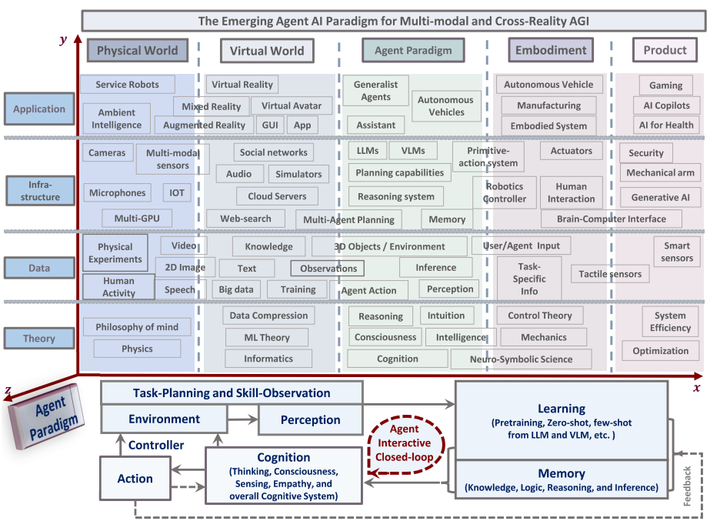
Future of AI Agents as the Operating Systems for Autonomous Robotics in Both Digital & Embodied Autonomous Systems
Source: https://arxiv.org/pdf/2401.03568

